Slide 1
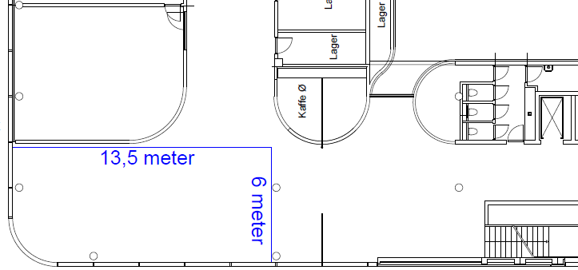
This one!
+3 posters for:
Reception
Nestor survey
Trends in dp future (everything else contribution)
Option 4
Minimal amount of walls
In total:
25 walls
42 posters
9 walls = 18 posters
6 walls = 6 posters
3 walls = 6 posters
2 walls = 2 posters
5 walls = 10 posters

